Slide 1
Indiana Pacers Performance Analytics Internship Project
Main Points
By: Tyler Fuelling

Slide 2
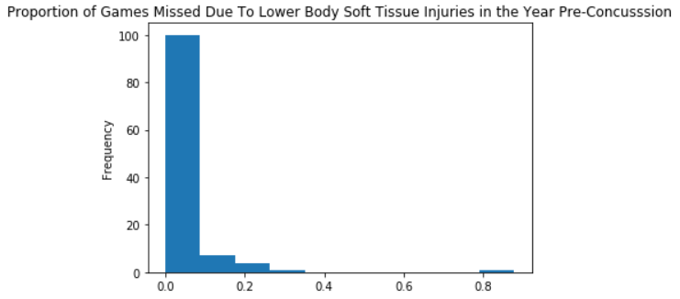
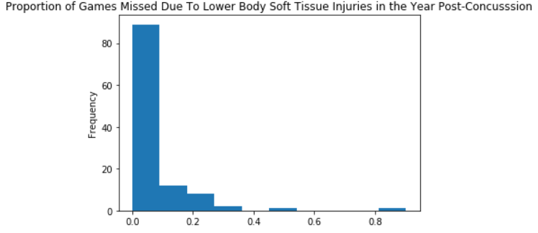
- Analyzing the frequency of past lower body soft-tissue injuries leading up to a concussion versus directly after a concussion did not provide enough evidence to conclude that lower body soft-tissue injuries are more frequent post-concussion that pre-concussion

Slide 3
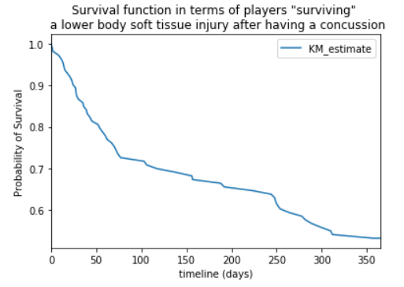
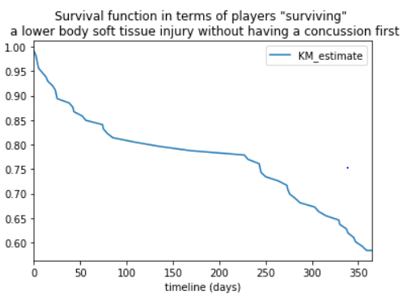
- However, analyzing survival curves for lower body soft-tissue injuries before and after a concussion provided enough evidence to conclude that NBA players who suffer a concussion are more likely to suffer a lower body soft-tissue injury sooner than players who did not have a concussion

Slide 4
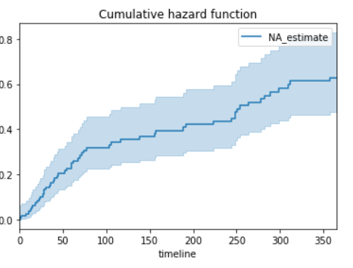
- Analyzing a cumulative hazard function for lower body soft-tissue injuries following a concussion provided enough evidence to conclude that lower body soft-tissue injuries are much more likely to occur in the 3 months directly following a concussion, with a fairly steep drop off after that

Slide 5
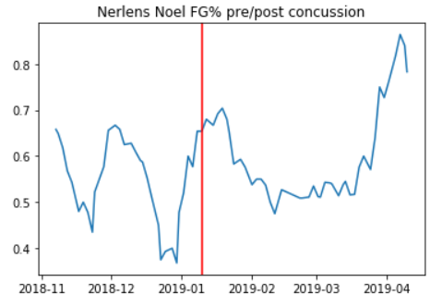
- Examining the rolling means/averages of different shooting percentage statistics both pre- and post-concussion did not provide any evidence that once a player returns to the lineup , his shooting percentage statistics (FG%, FT%, 3P%, and eFG%) are at all effected by previously suffering a concussion

